Slide 1
Big Mountain Resort Ticket Pricing
Blaine murphy
4/3/2021

Slide 2
Executive Summary
Recent investment in a new chair lift drove examination of lift ticket pricing to ensure Big Mountain optimally capitalizes resort facilities
Following analysis and predictive modeling of ~300 resorts nation wide, the model suggested lift ticket price is $94, compared to the current ticket price of $81
This is a $13 increase which is greater than the mean absolute error in the prediction of $10.39
Assuming steady customer numbers, an increase of $0.88 will cover the cost of new ski lift
I recommend a lift ticket price of $90 to increase capitalization of Big Mountain facilities while also not pricing out local Montanans
New predictive model will help investment decision making in the future

Slide 3
Problem
Recent investment in new chair lift raising annual operating costs $1.54MM
There is a feeling from management that lift ticket is not optimally priced to capitalize on Big Mountain facilities.
The focus of this project is to examine other ski resorts nationwide and create a model to predict market pricing from resort data
Success will be achieved if a new data-driven ticket price increases profits by 5% on top of the new lift expenses

Slide 4
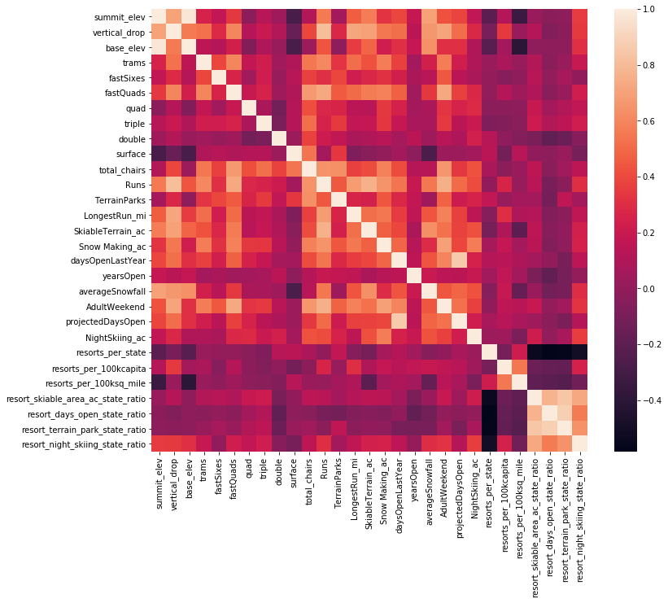
Exploratory Data Analysis
Data aggregated by state to understand state wide resort market.
No trends seen so proceed treating all states equally
Adult weekend ticket price chosen to be the target, because it is more prevalent in the dataset
Top correlating features to ticket price:
Number of runs
Number of fast quad lifts
Snow making acreage
Total number of chair lifts

Slide 5
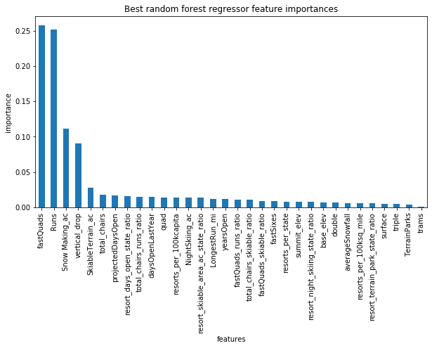
Model training
Created Random Forest model to predict weekend lift ticket price
During training number of estimators was a variable, model with highest cross-validation fit has 69 estimators
Best model mean cross validation R² is ~0.71
Cross validation shows no increase in predictive accuracy beyond 60 samples of the data set, i.e. the model has plenty of data to be predictive
Top predictive features:
Number of fast Quad lifts
Number of runs
Snow making acreage
Vertical drop

Slide 6
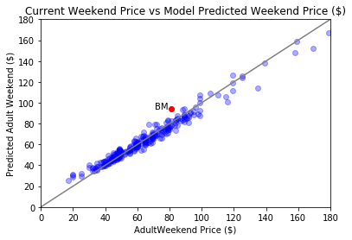
Modeling
Applying the model to the full data set returns a mean absolute error value of $10.39 with a standard deviation of $1.49
Applying the model to Big Mountain resorts’ facilities returns a predicted ticket price of $94.22
Plotting the current prices against the model predicted prices shows the model is quite accurate, especially in the segment of the price distribution where Big Mountain falls

Slide 7
Summary
The ML model predicted lift ticket price is $94.22 compared to the current price of $81.
This increase is greater than the mean absolute error in the model prediction of $10.39
This prediction was driven ~300 nationwide ski resort facilities and ticket pricing and by Big Mountain’s current facilities
I recommend to increase the lift ticket price to $90 for the upcoming ski season
The model is now available to run various scenarios and predict the resulting market supported lift ticket price

